Slide 1
Project 3 – Web APIs & Classification
by Ferdi Garcia

Slide 2
Problem Statement
Collect enough posts from 2 subreddit posts (from Reddit) of your choosing. You can either use an API or webscraping process to gather your data.
Using NLP process learned in class, proceed to train a classifier to the collected subreddit posts. Note that this is a binary classification problem.
Compare 2 models where one model must use a Bayes –related classifier; the other can be of your choosing.
To analyse and present the results of the modelling process.

Slide 3
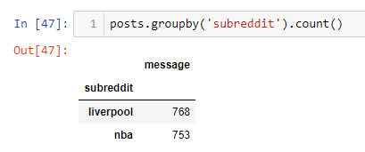
Executive Summary Project 3 will measure our ability to source and gather data to run a classifier model. Below is the summary of the tasks:
Extract data from my chose Reddit posts.
I chose the topic of “Liverpool FC” and “NBA” posts. This is to provide the necessary contrast between the 2 posts for the classifier process.
I applied a “sleep time” of 30 mins per extraction run to collect 25 messages per post. I resulted in extracting the following number of posts:
Liverpool FC = 768 messages
NBA = 753 messages

Slide 4
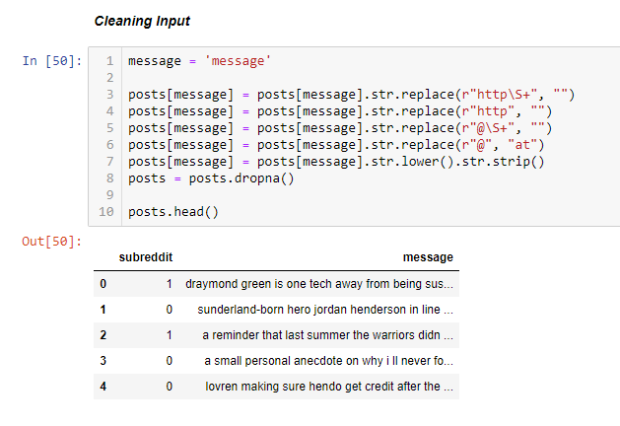
Executive Summary
I created a new Jupyter notebook that incorporates the following;
Loading of the gathered data:
I mapped the following values accordingly to the column “reddit”
Liverpool FC = 0 (value zero)
NBA = 1 (value 1)
Initial Cleaning:
Drop NULL rows
Replace occurrence of "http\S+" with spaces.
Replace occurrence of "http+" with spaces.
Replace occurrence of "@\S+" with spaces.
Convert all letters to lower case.

Slide 5
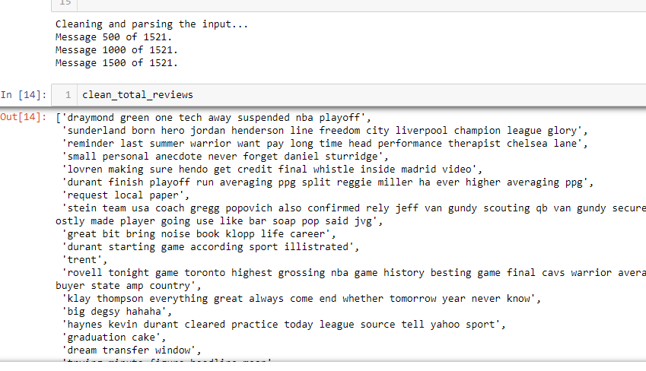
Executive Summary
Consolidated Cleaning:
I created a function to provide consolidated cleaning across all of the rows:
Remove HTML using the BeautifulSoup module
Remove non-letters using the regex module
Split into individual words using the tokenizer module
Group together related words to identify variant forms of words using the Lemmatizer module
Exclude Stopwords from the messages (Stopwords downloaded separately)
Join the words back into one string separated by space.
The cleaned messages were kept on a list “clean_total_reviews”.

Slide 6
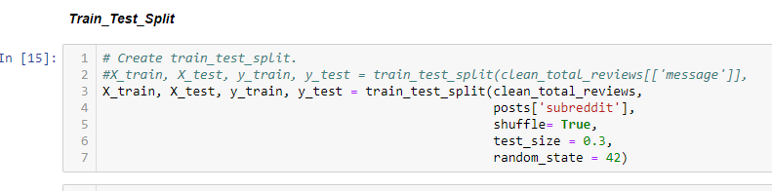
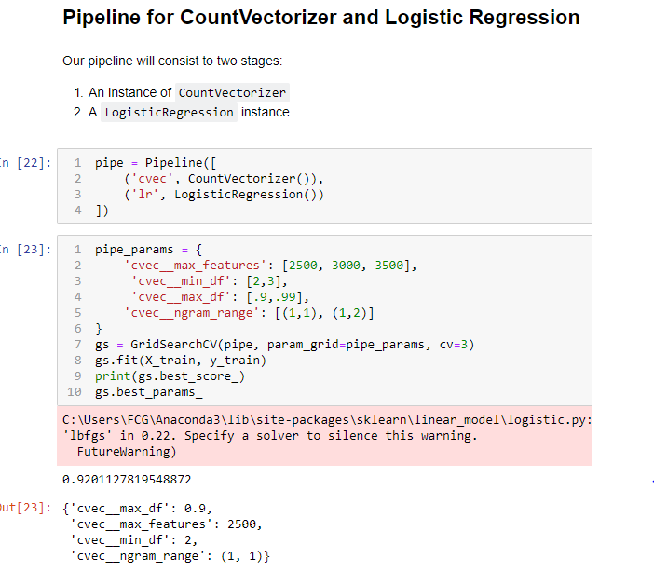
Executive Summary
Train-Test Split
Ran the Train-Test Split using the following
Input: clean_total_reviews list and post.subreddit
Output: X_train, X_test, y_train, y_test
Settings: shuffle = True, test size = 0.3, random state = 42
Pipeline for CountVectorizer and Logistic Regression
The pipeline will consist to two stages:
An instance of CountVectorizer
A LogisticRegression instance
The gs.best score for the .gs.fit = 0.9201127819548872
Pipeline for CountVectorizer, TfidfTransformer and MultinomialNB
The pipeline will consist to three stages:
An instance of CountVectorizer
A TfidfTransformer instance
A Naïve Bayes Multinomial instance
The gs.best score for the .gs.fit = 0.9201127819548872

Slide 7
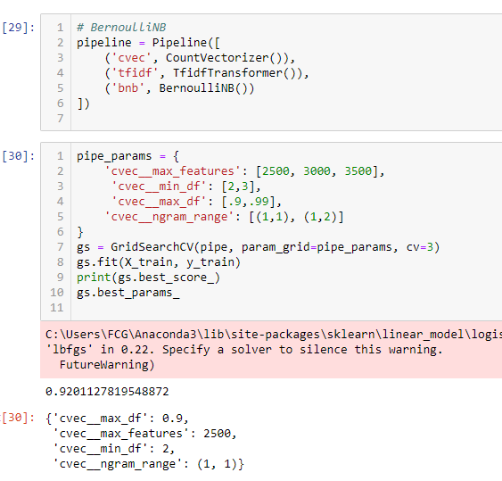
Executive Summary
Pipeline for CountVectorizer, TfidfTransformer and BernoulliNB
The pipeline will consist to three stages:
An instance of CountVectorizer
A TfidfTransformer instance
A Naïve Bayes Bernoulli instance
The gs.best score for the .gs.fit = 0.9201127819548872
Classification Report
Below is the outcome of the Classification Report:
Logistic Regression accuracy 0.9431072210065645

Slide 8
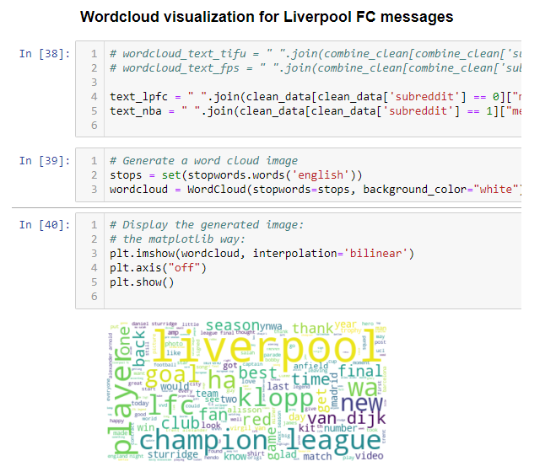
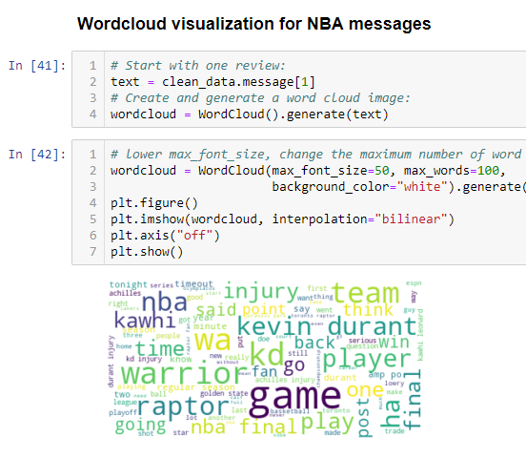
Executive Summary
Wordcloud Visualization
Word cloud is one of the visualizations used to highlight the dominant topics of a post. I did one for each of the posts. The graphics correctly most of the “popular” topics of the posts.

